Slide 1
02-Kafka Basics

Slide 2
What you will learn in this course 🧐🧐
It's time to learn about Kafka. Created by the famous Apache Foundation, Kafka is a tool to process data in real time and behind the concept of real-time there are a lot of new paradigms that you need to understand. That is why in this course, we will cover:
Kafka basic vocabulary
Kafka and Confluent
Kafka and Confluent installation

Slide 3
Kafka basic vocabulary
Now that you are dealing with streaming data, there are a few concepts that you need to understand before getting your hands dirty with the code. This vocabulary is:
Brokers - It's the actual hardware (or instances like EC2) where Apache Kafka is hosted. There are usually several brokers in a cluster as Kafka is fundamentally distributed.
Events - Think of an event as the trigger that tells a machine that something happened. It can be an IoT device reporting temperature inside a building, or a post on social media.
Topics - Events are stored in Topics that a machine will then write data to or consume data from. Topics are broken down into partitions.
Producers - Devices or programs that produce data (i.e a web application like Google Analytics, a web scraper, an API)
Consumers - Devices or programs that use data from a topic (i.e a Machine Learning model, a database, another API)

Slide 4
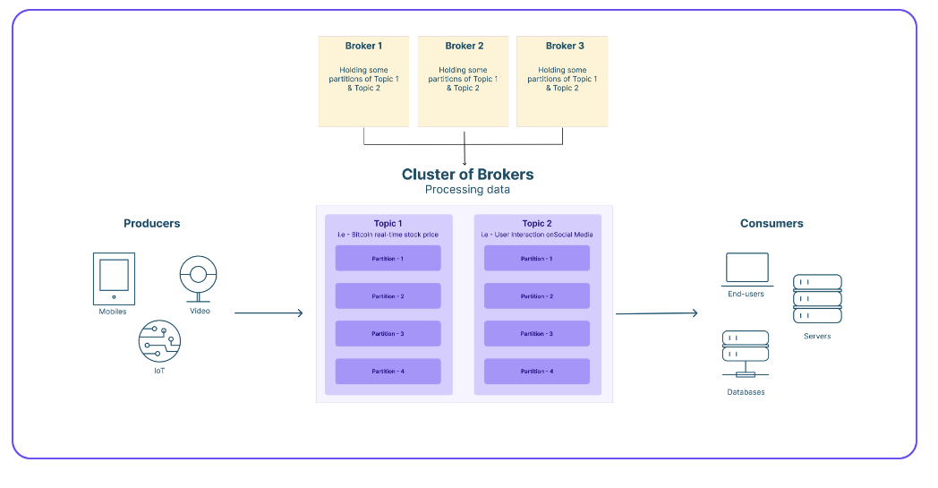

Slide 5
Install Kafka
Let's go ahead and set up an environment to produce and consume real-time data. To use Kafka, we will use a platform called Confluent. As create a Kafka cluster is extremely cumbersome, it is an easy way to get started writing actual code that would benefit your actual business.
Before showing you how to set up, we want to mention that Confluent offers two products:
Confluent Cloud
Confluent Platform
The first one is the all-packaged paid Kafka cluster. The second one is the open-source version. As you get a $400 credit on the platform, we'll be using Confluent Cloud version as we want you to spend time learning how to code programs that leverage real-time data rather than spending time on installations that will most likely already be done in the companies you'll work for.
We'll still provide you with an installation guide for Confluent Platform if you're curious of how it works 😉

Slide 6
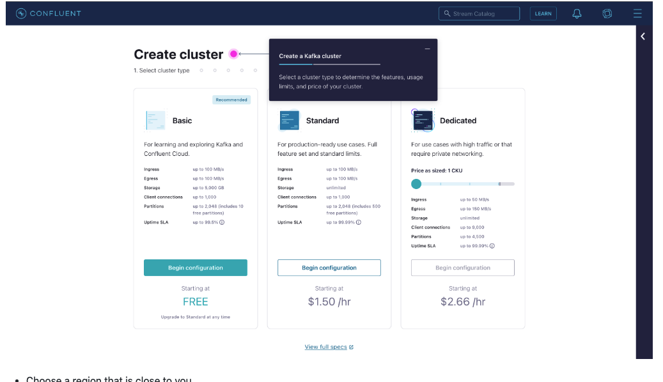
Install Kafka with Confluent Cloud
Without further ado, let's start by setting up your Confluent Cloud Kafka cluster. To do so:
Sign-up to Confluent Cloud - https://confluent.cloud/signup
Fill out your information
Confirm your email
Set up your cluster

Slide 7
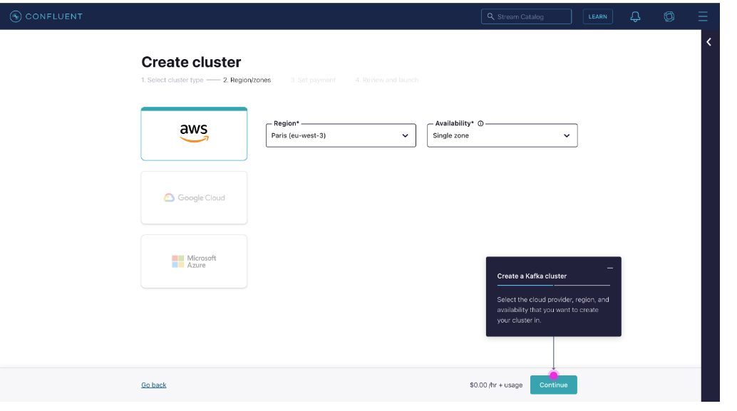
Install Kafka with Confluent Cloud
Choose a region that is close to you

Slide 8
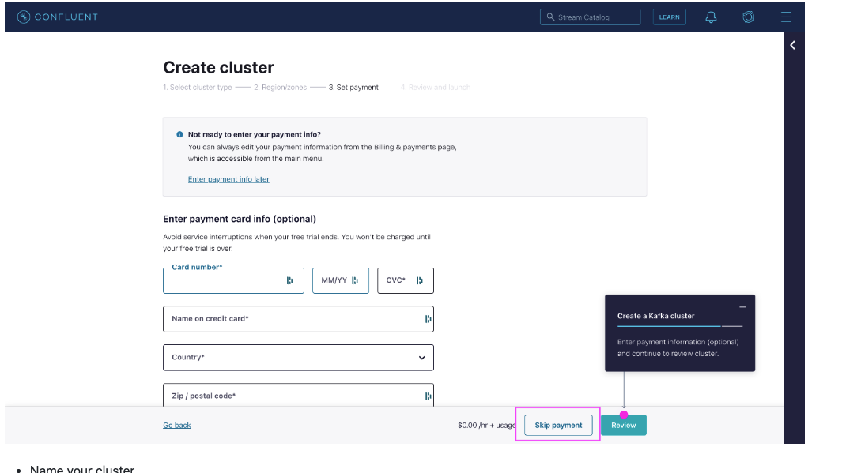
Install Kafka with Confluent Cloud
You will be prompted to a form asking for your credit card information, simply click on "skip" if you don't want to provide them

Slide 9
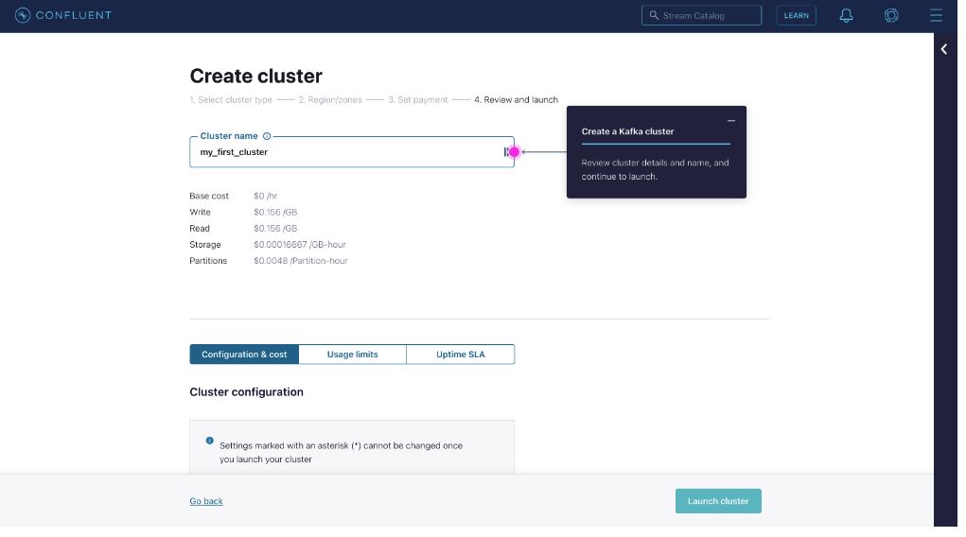
Install Kafka with Confluent Cloud
Name your cluster

Slide 10
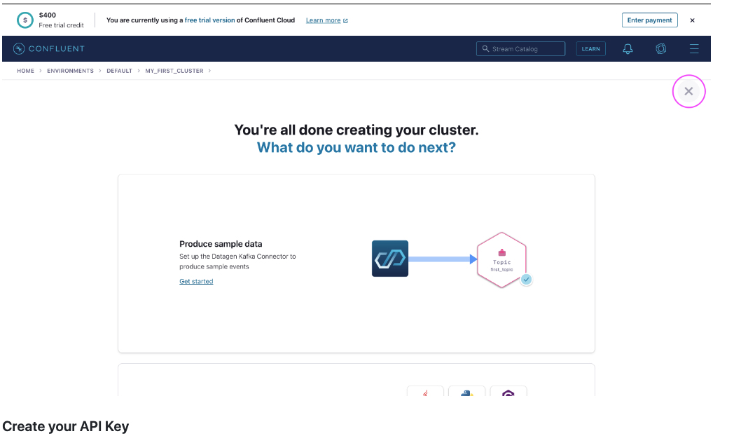
Install Kafka with Confluent Cloud
At the point, you should be all set. You can skip the setup tutorials as we will cover that in greater details in the next section of the course:

Slide 11
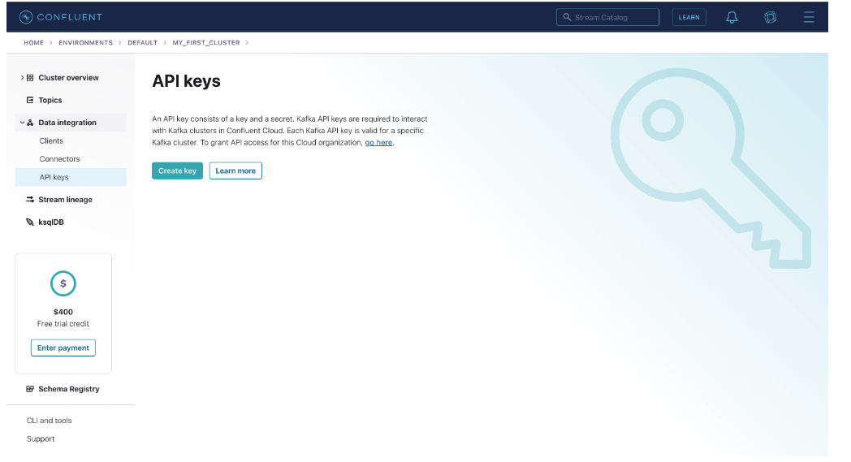
Create your API Key
As a final step, you will need to create an API Key that you will be using each time you will need to connect to your cluster. Simply go into Data Integration > API Keys > Create Key
Choose Global Access
Download your API Key and store it somewhere safe. You won't be able to retrieve it afterwards.
Now you are all done! 🥳

